Slide 1
Our Transition Chart – Model 1
Gray
Door
Probability = #Blue Neighbours/
#Neighbours
Blue
Door
Model 1 - A “flip” scenario
# Neighbours = 4
# Blue= 1
Let P = 1/4 = 0.25
Let’s say R = 0.24
R < P Then FLIP

Slide 2
Our Transition Chart – Model 2
Gray
Door
Probability = Lambda
Blue
Door
Model 2 - A “flip” scenario
# Blue Neigbours = 1
B = 1
P = 0.15
(Probability of imitating neighbour)
# Reed-Frost Equation
Let Lambda = 1 – (1-P)^B
Evaluates to 0.15
Let’s say R = 0.14
R < Lambda Then FLIP

Slide 3
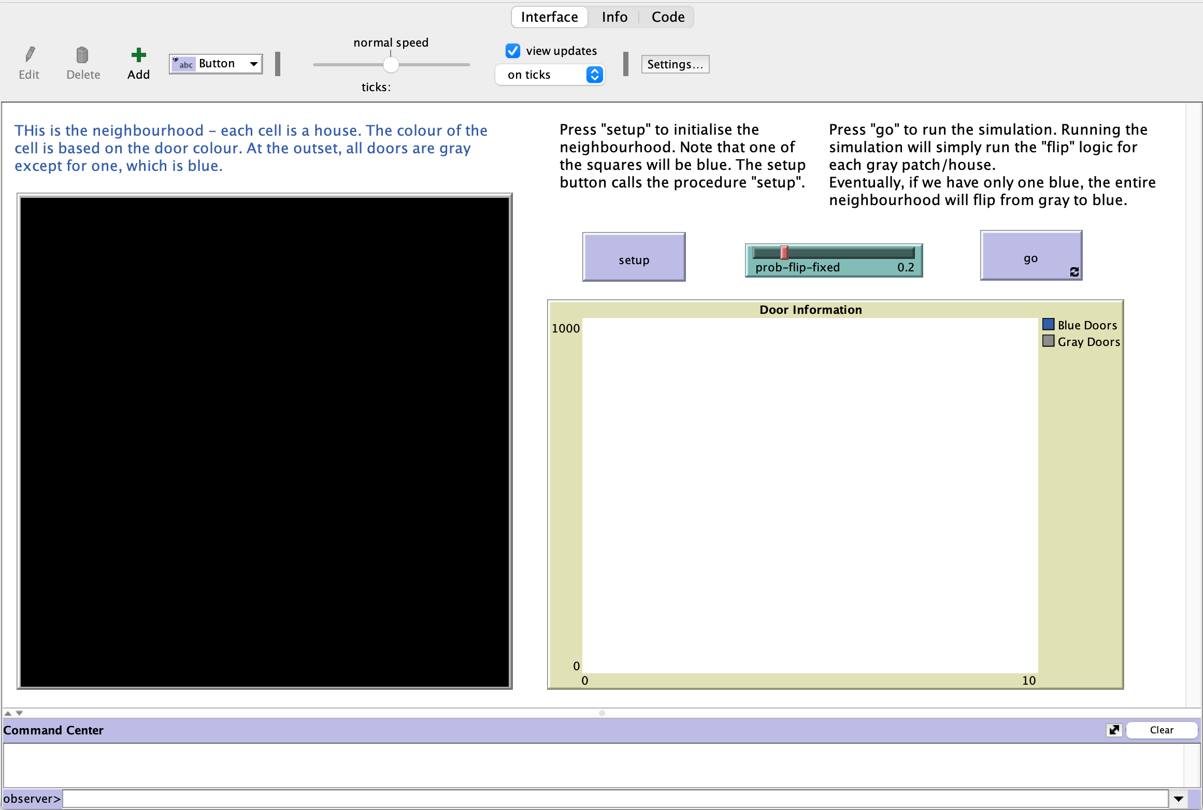

Slide 4
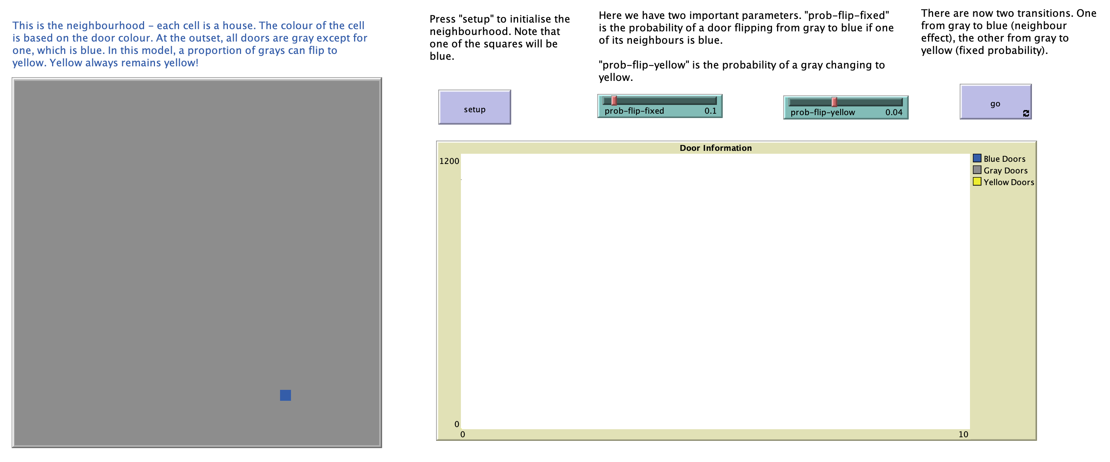
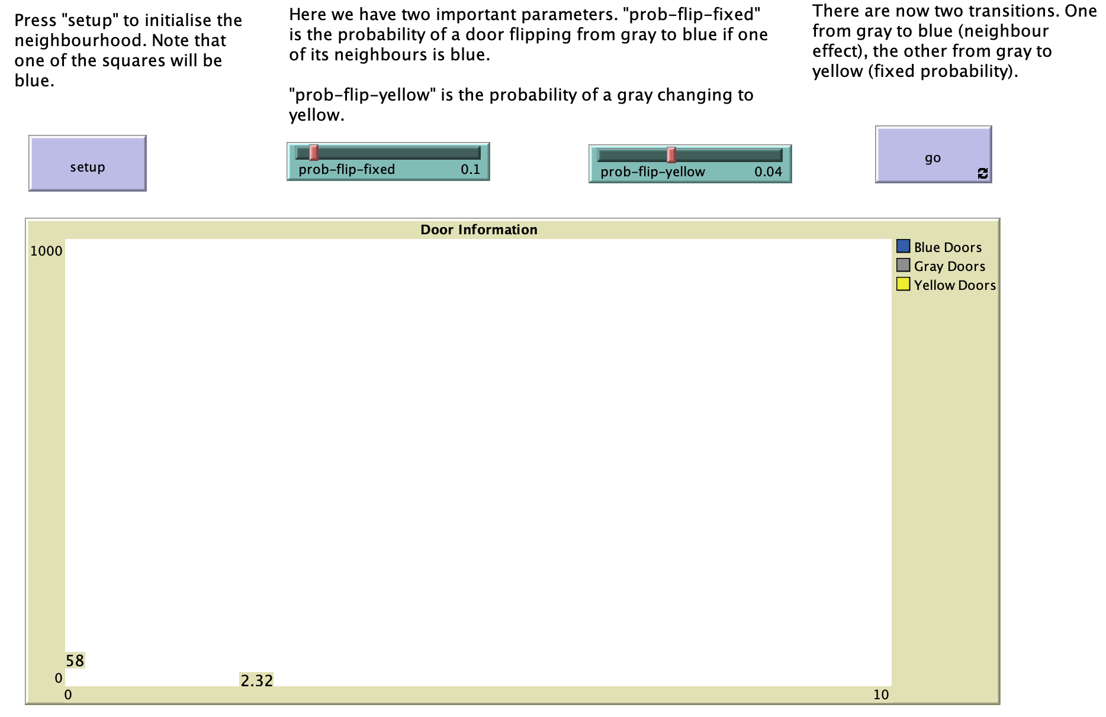

Slide 5
Our Transition Chart – Model 3
Gray
Door
Probability = Lambda
Blue
Door
Probability = prob-flip-yellow
Yellow
Door
Model 3 - A “flip” scenario
prob-flip-yellow = 0.01
Let’s say R = 0.006
R < prob-flip-yellow Then FLIP-Yellow

Slide 6
